Slide 1
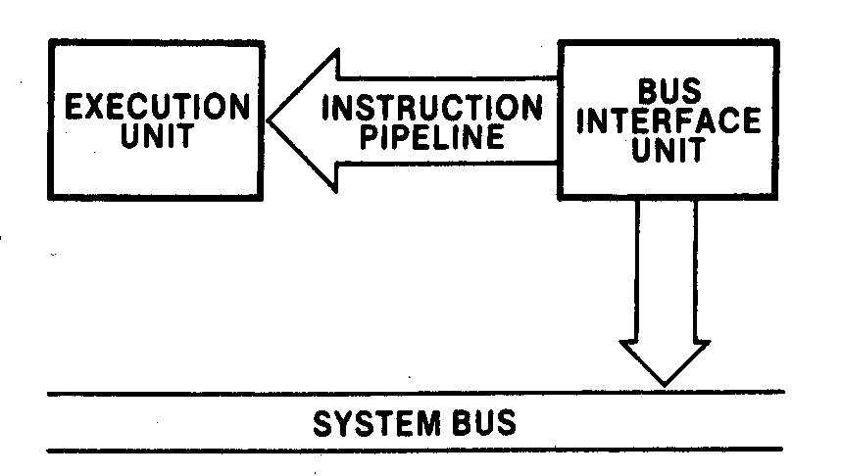
Chapter 2
Software Architecture of the 8088/8086 Microprocessors
Pipelined architecture of the 88/86 microprocessors

Slide 2
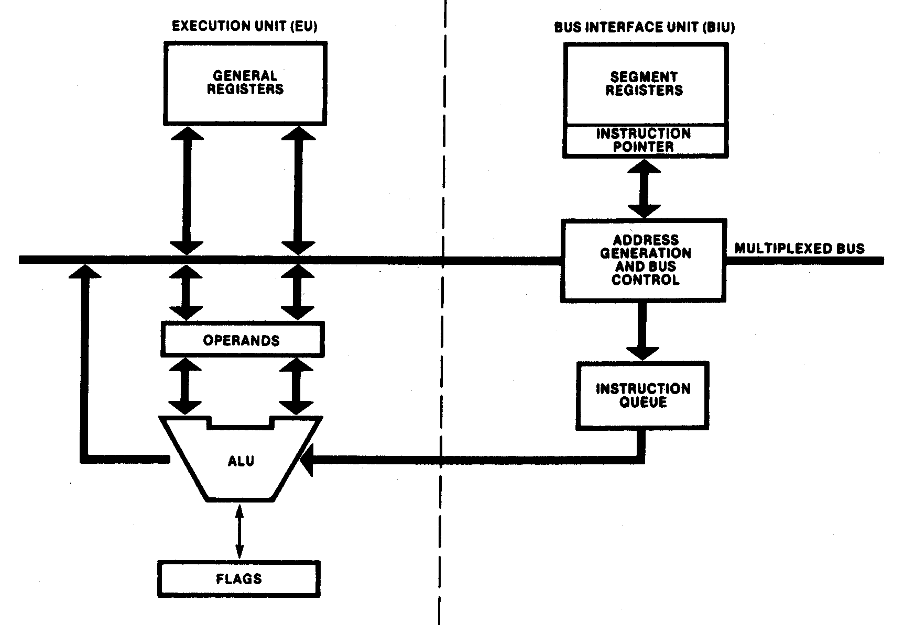
Execution and bus interface units

Slide 3
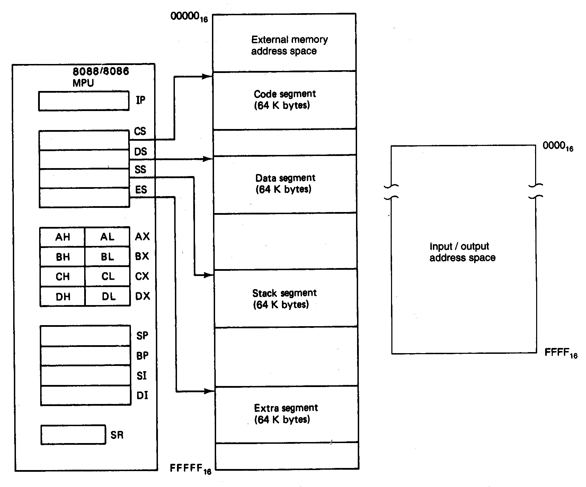
2.2 Software Model of the 88/86 Microprocessors

Slide 4
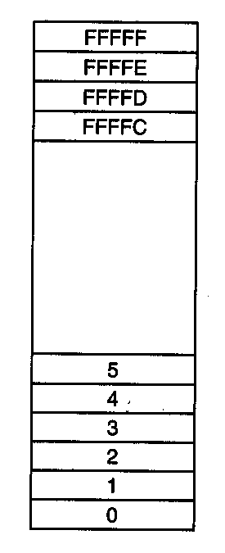
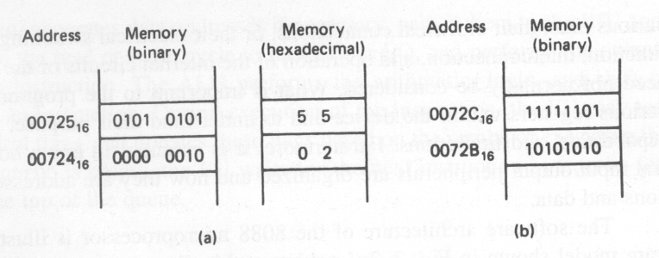
2.3 Memory Address Space and Data Organization
Storing a word in memory
What is the word in (b) in Hex?
Memory address space

Slide 5
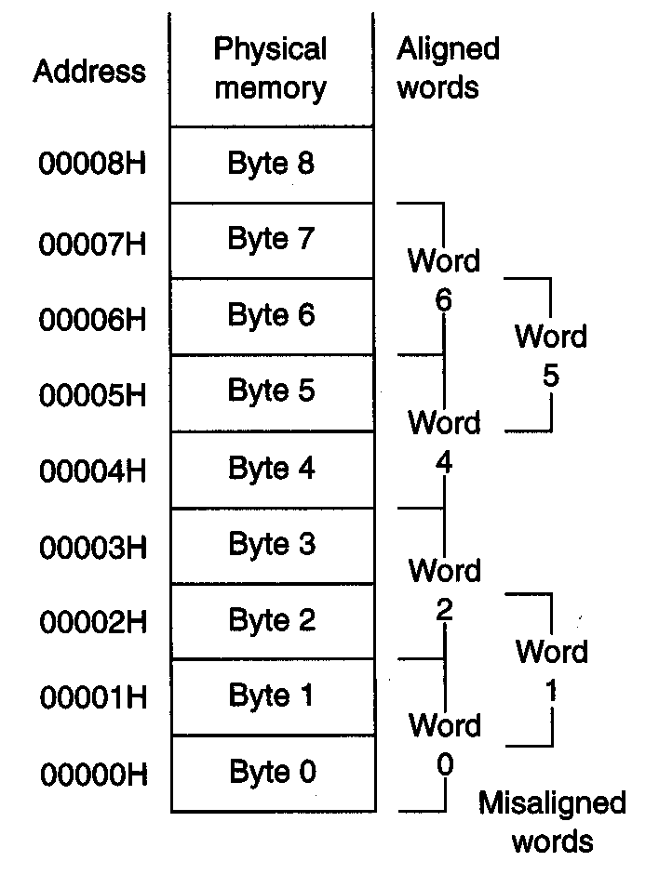
Aligned and misaligned data word
Is the word stored in (b) aligned ?

Slide 6
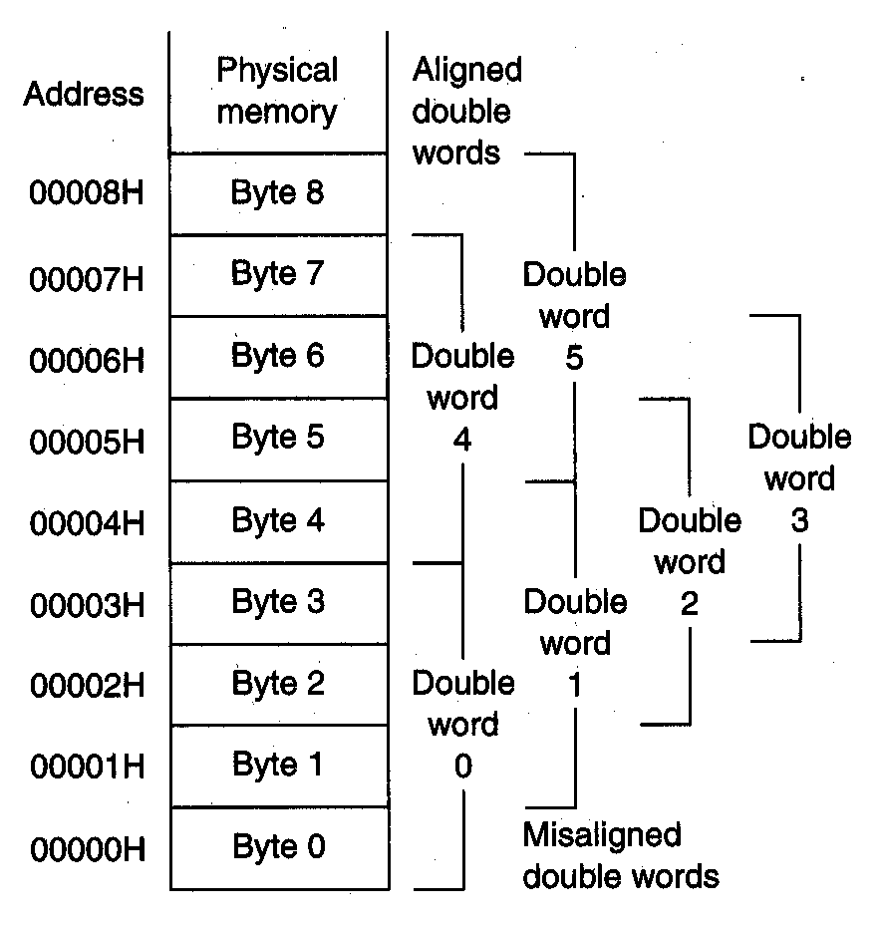
Aligned and misaligned double words of data

Slide 7
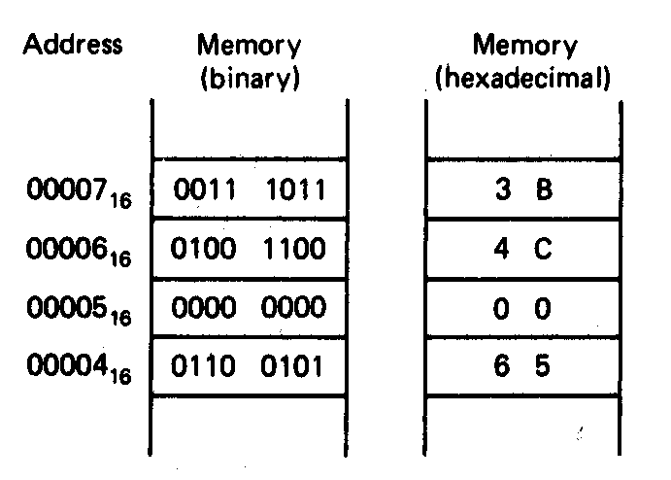
Storing double word in memory

Slide 8
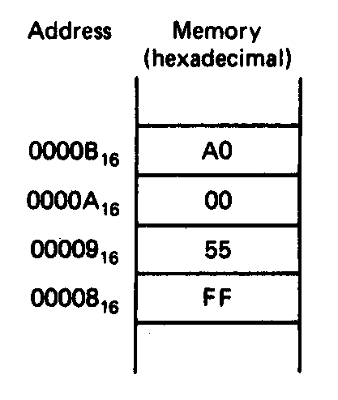
Example:
How should the pointer with segment base address equal to A000H and offset address 55FFH be stored at an even-address boundary at 0008H?
Is the double word aligned?

Slide 9
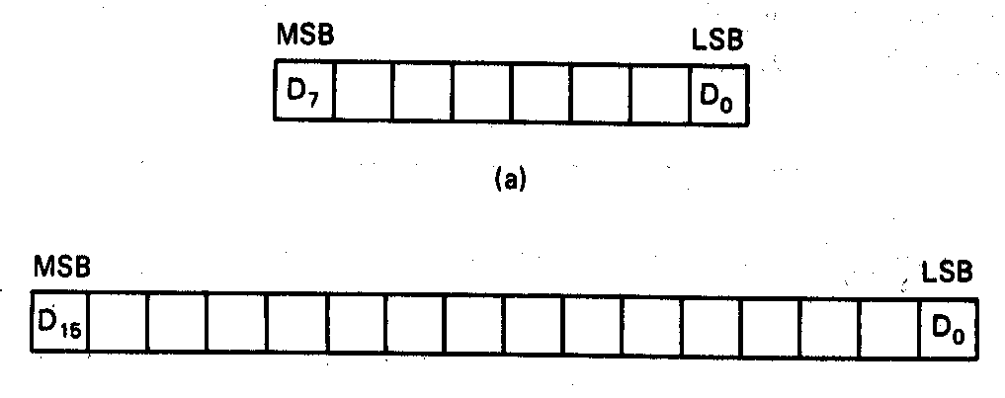
2.4 Data Types
Unsigned byte integer
0 - 255
Unsigned word integer
0 – 65,535

Slide 10
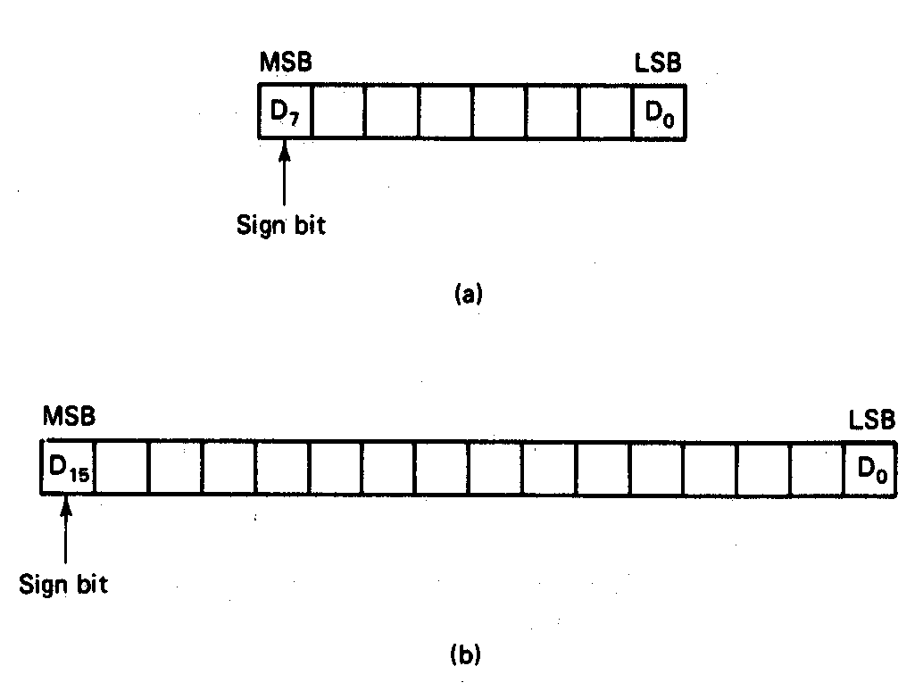
Signed integers
-128 - +127
-32,768 - +32,767

Slide 11
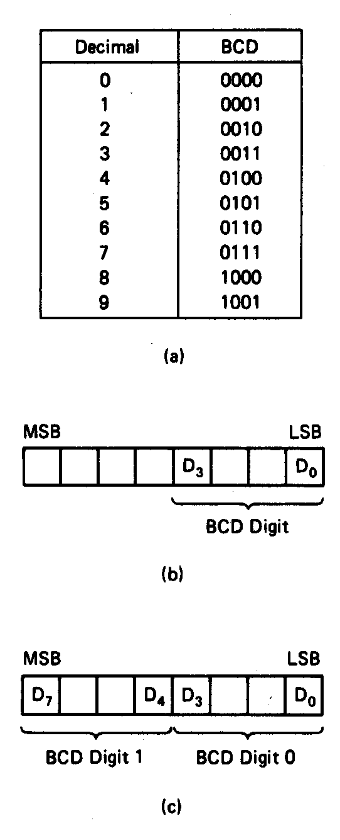
Binary Coded Decimal (BCD)
Unpacked BCD
Packed BCD

Slide 12
Example:
The packed BCD data stored at byte address 01000H equals 10010001₂. What is the two-digit decimal numbers?
10010001₂ =1001_{BCD} 0001_{BCD} = 91₁₀

Slide 13
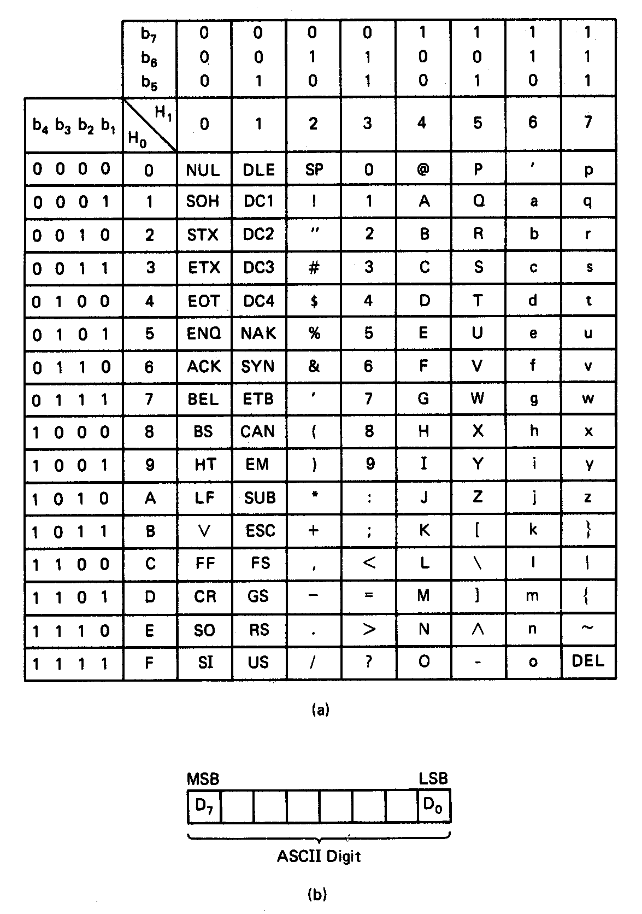
American Standard Code for Information Interchange ASCII

Slide 14
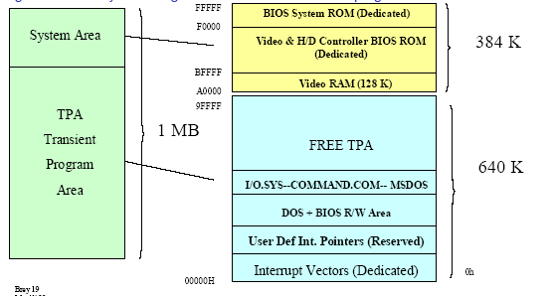
2.6 Dedicated, Reserved, and General use Memory
Some address locations have dedicated functions and should not be used as
general memory for storage of data or instructions of a program
128 Bytes
1MB=1,048,576

Slide 15
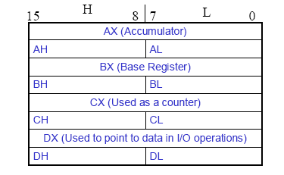
2.8 Data Registers
• Normally used for storing temporary results
• Each of the registers is 16 bits wide (AX, BX, CX, DX)
• Can be accessed as either 16 or 8 bits AX, AH, AL

Slide 16
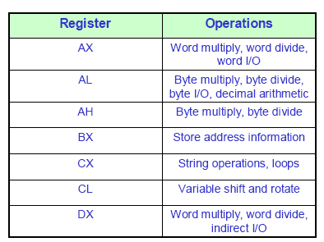

Slide 17
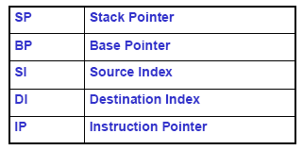
2.9 Pointer and Index Registers
All 16 bits wide, L/H bytes are not accessible
Used as memory pointers
• Example: MOV AH, [SI]
  Move the byte stored in memory location whose address
  is contained in register SI to register AH
IP is not under direct control of the programmer

Slide 18

2.10 Status Register (Control Flags)
• Six of the flags are status indicators reflecting properties of the last
arithmetic or logical instruction.
• For example, if register AL = 7Fh and the instruction ADD AL,1
is executed then the following happen
AL = 80h
CF = 0; there is no carry out of bit 7
PF = 0; 80h has an odd number of ones
AF = 1; there is a carry out of bit 3 into bit 4
ZF = 0; the result is not zero
SF = 1; bit seven is one
OF = 1; the sign bit has changed
• Can be used to transfer program control to a new memory location;
for example: ADD AL,1
JNZ 0100h

Slide 19
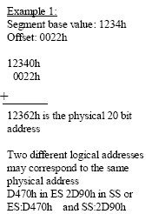
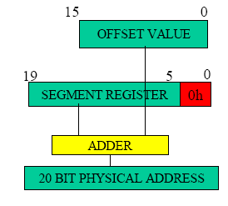
2.11 Generating A Memory Address
• Addresses within a segment can range from address 0 to address
FFFFh. This corresponds to the 64Kbyte length of the segment
• An address within a segment is called an offset or logical address

Slide 20
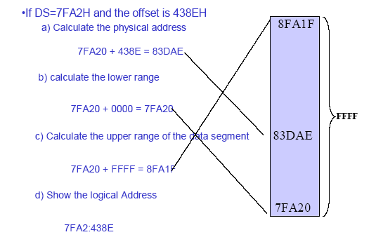
Example:

Slide 21
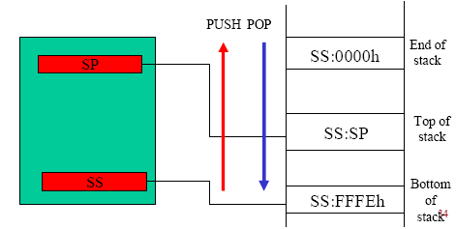
2.12 The Stack
The stack is used for temporary storage of information such as data or
addresses; for instance when a CALL is executed the 8088
automatically PUSHes the current value of CS and IP onto the stack.
• Other registers can also be pushed
• Before return from the subroutine, POP instructions can be used to pop
values back from the stack into the corresponding registers

Slide 22
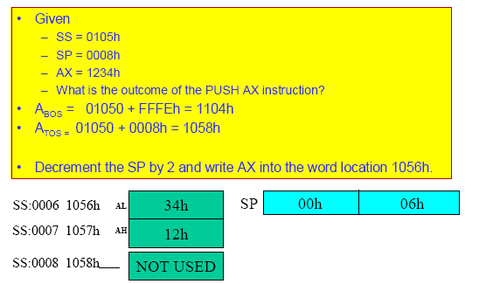
Example for PUSH

Slide 23
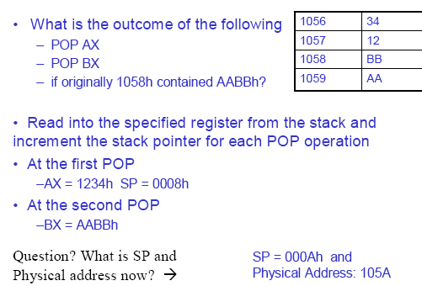
Example for POP

